Slide 1
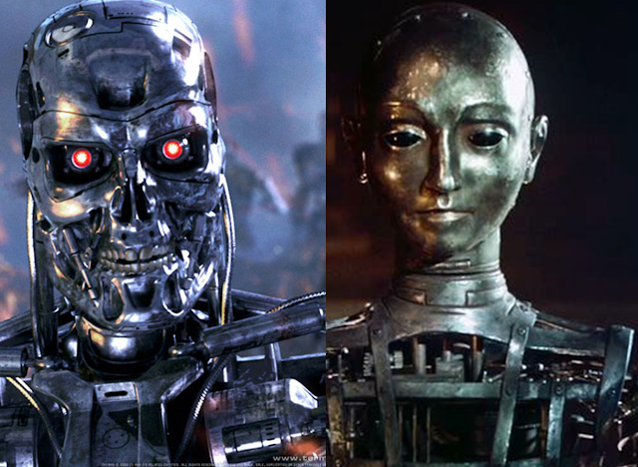
Theory Of Automata
1
Notes:
<number>

Slide 2
Course Details
Course Title : Theory of Automata
Credit hours : 2+0
Recommended Books:
Introduction to Computer Theory, by Daniel I. Cohen, John Wiley and Sons, Inc., 1991, Second Edition (as a Text Book)
Introduction to Languages and Theory of Computation, by J. C. Martin, McGraw Hill Book Co., 1997, Second Edition (for Additional Reading)
1

Slide 3
Marks Distribution
Assignments
Quizzes
Mid-term
Theory paper
Presentation
1

Slide 4
DON’T FORGET
75% of the attendance is compulsory to be appear in the Final exam
1

Slide 5
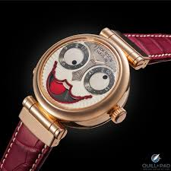
Let’s get started……
1

Slide 6
Lecture # 01
Theory of Automata
6

Slide 7
What is an Automaton?
Generally speaking, an automaton (plural automata) is a self operating machine.
An abstract machine , a mathematical model.
Automaton = An abstract computing device
6

Slide 8
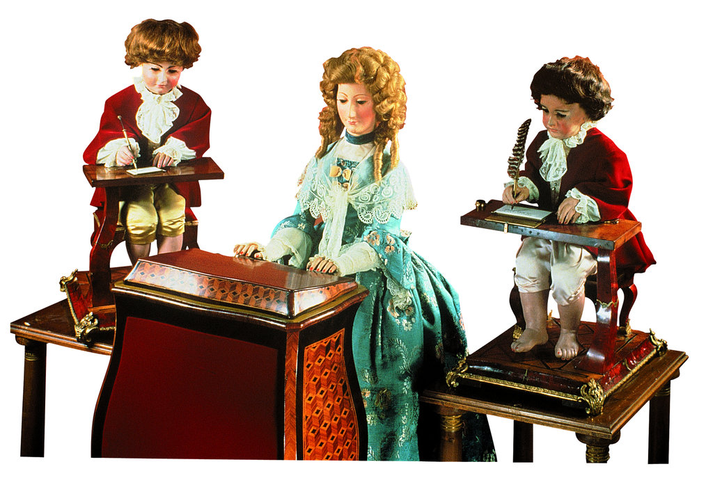
What is Automata?
It is the plural of automaton, and it means “something that works automatically”.
6

Slide 9
What does Theory of Automata mean?
The word “Theory” means that this subject is a more mathematical subject and less practical.
However, this subject is the foundation for many other practical subjects.
In general, this subject focuses on the theoretical aspects of computer science.
9

Slide 10
Some other names ,
Theory of Computer Science
Theory of Computation
Computer Theory
Automata Theory
9

Slide 11
Theory of Automata
Automata theory is the study of abstract computational devices and the computational problems that can be solved using them.
Abstract devices are (simplified) models of real computations
9

Slide 12
Applications
Helps in design and construction of different software's and what we can expect from our software's.
Automata plays a major role in:
Theory of Computation
Compiler Construction
Parsing
Formal Verification
Defining computer languages
Artificial Intelligence
12

Slide 13
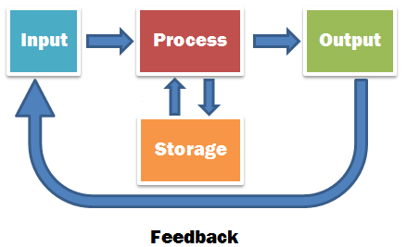
Introduction to Languages
Machines work on certain instructions (language).
Instructions must be given in a proper way so that machine can understand it.
It deals with the study of abstract machine as well as computational problems
12

Slide 14

Types of Languages
Informal language (Talking languages)
Programming language
Formal Languages (Syntactic languages)
Will discuss it later but first we must know what is a language ….
14

Slide 15

Language
A set of strings with some rules.
Made up of letters , characters and symbols.
Letters : Characters and symbols which combine to form a language for a machine.
Example: [a,b,c,….] ,[0,1,2,….]
14

Slide 16
Alphabets:
A finite non-empty set of symbols (letters)
It is denoted by Σ ( Greek letter sigma).
Example
Σ = {a, b} (Two character language)
Σ = {0,1} (Binary language)
14

Slide 17
Defining Alphabets – Guidelines
The following are three important rules for defining Alphabets for a language:
Should not contain empty symbol Λ
Should be finite. Thus, the number of symbols are finite
Should not be ambiguous
14

Slide 18
Ambiguity
Example:
An alphabet may contain letters consisting of group of symbols for example
Σ₁= {A, aA, bab, d}.
Now consider an alphabet
Σ₂= {A, Aa, bab, d} and a string AababA.
17

Slide 19
This string can be factored in two different ways
(Aa), (bab), (A)
(A), (abab), (A)
Which shows that the second group cannot be identified as a string, defined over Σ = {a, b}.
This is due to ambiguity in the defined alphabet Σ₂
17

Slide 20
Why Ambiguity comes: A computer program first scans A as a letter belonging to Σ₂, while for the second letter, the computer program would not be able to identify the symbols correctly.
Ambiguity Rule:- The Alphabets should be defined in a way that letters consisting of more than one symbols should not start with a letter, already being used by some other letter.
17

Slide 21
Ambiguity Examples
Σ₁= {A, aA, bab, d}
Σ₂= {A, Aa, bab, d}
Σ₁ is a valid alphabet while Σ₂ is an in-valid alphabet.
Similarly,
Σ₁= {a, ab, ac}
Σ₂= {a, ba, ca}
In this case, Σ₁ is a invalid alphabet while Σ₂ is a valid alphabet.
17

Slide 22
String
Concatenation of finite symbols from the alphabet.
Formed by combining various symbols from an alphabet.
Example:
If Σ= {a, b} then
a, aa, ab, bb, abab, aabb, ababababababababab
22
Notes:
<number>

Slide 23
Example
Make a language for a machine from alphabet {a,b} in which strings starts and ends with ‘a’
22

Slide 24
Word
Strings belonging to some language
A string that is permissible in language
Example:
If Σ= {a} then a language L can be defined as
L={a,aa,aaa,….}
NOTE:
All words are strings, but not all strings are words
22

Slide 25
Empty String
A string with no symbol at all
Denoted by (Small Greek letter Lambda) λ or (Capital Greek letter Lambda) Λ,
Also called a null string
22

Slide 26
Length of string
It is the number of letters in the string
The length of string s, denoted by |s|
Example:
Σ={a,b}
s=ababa
|s|=5
The length of empty string will be equal to zero
<number>

Slide 27
Example:
Σ= {B, aB, bab, d}
s=BaBbabBd
Tokenization=(B), (aB), (bab), (B), (d) |s|=5
<number>

Slide 28
Reverse of string
It is obtained by writing the letters of s in reverse order.
The reverse of a string s denoted by Rev(s) or s^{r}
Example:
If s = abc is a string defined over
Σ={a,b,c} then
Rev(s) or s^{r} = cba
<number>

Slide 29
Example:
Σ= {B, aB, bab, d}
s=BaBbabBd
Tokenizing=(B) (aB) (bab) (B) (d)
Rev(s)=dBbabaBB
<number>

Slide 30
Example:
Σ= {A, aA, bab, d}
s=AaAbabAd
Rev(s)=dAbabaAA or
Rev(s)= dAbabAaA
Which one is correct?
<number>

Slide 31
Power of an alphabet
Determines that the string made from alphabet will be of length equal to power of alphabet.
Formula: Number of strings of length ‘m’ defined over alphabet of ‘n’ letters is n^{m}
where ,
n= Total number of letters in alphabet
m= Power/length
<number>

Slide 32
Examples:
The language of strings of length 2, defined over Σ={a,b}
L={aa, ab, ba, bb} i.e. number of strings = 2²
The language of strings of length 3, defined over Σ={a,b}
L={aaa, aab, aba, baa, abb, bab, bba, bbb} i.e. number of strings = 2³
<number>

Slide 33
Power of string
Determine the length of the string
Example:
(bab)² = baba
ba² b= baab
<number>

Slide 34
Lecture Summary
Definition of the word Automata
Types of languages, empty/Null String, Alphabets , Ambiguity, words, length of strings.
Power of alphabets and strings
<number>

